Slide 1

Varendra University
Dept. of Computer Science & Engineering (CSE)
Microprocessor
Course Title: Microprocessor and Assembly Language
Course No: CSE 3205
Prepared By:
Md. Adnan Sami
Lecturer, Dept. of CSE, VU

Slide 2
Outline
8086 Microprocessor Organization.
Functional Block of 8086 Microprocessor.
How does queue speed up the processing of the 8086 microprocessor?
Register of 8086 Microprocessor.
Instruction set of 8086 microprocessor.

Slide 3
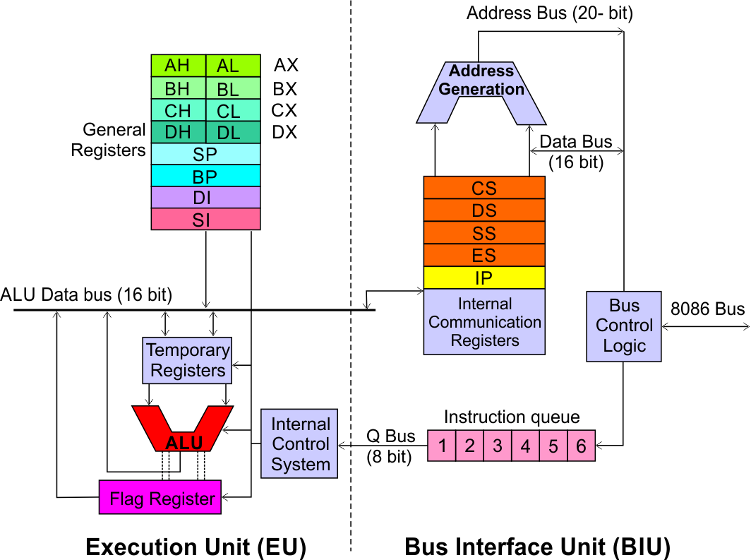
8086 Microprocessor Organization
Execution Unit (EU)
Instruction decode and execute.
Arithmetic and logical operation.
Bus Interface Unit (BIU)
Instruction fetch.
Address generation.
Memory and I/O communication.

Slide 4
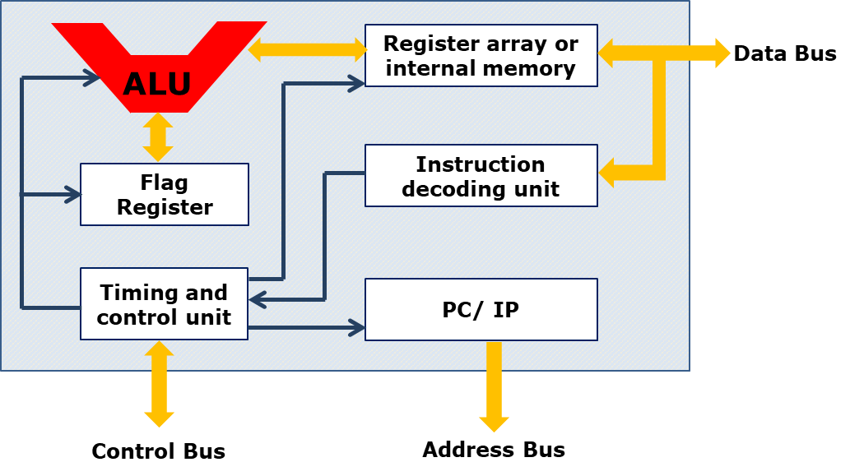
Functional Block of 8086 Microprocessor

Slide 5
Functional Block of 8086 Microprocessor
Computational Unit; performs arithmetic and logic operations
Various conditions of the results are stored as status bits called flags in flag register
Internal storage of data
Register array or internal memory
Data Bus
ALU
Generates the address of the instructions to be fetched from the memory and send through address bus to the memory
Flag Register
Instruction decoding unit
Timing and control unit
PC/ IP
Control Bus
Address Bus
Generates control signals for internal and external operations of the microprocessor
Decodes instructions; sends information to the timing and control unit

Slide 6
How does queue speed up the processing of the 8086 microprocessor?
The 8086 microprocessor's 6-byte instruction queue increases speed through instruction prefetching. The BIU fetches instructions and stores them in the queue. At the same time, the EU executes the instructions. Because of instruction fetching and execution overlap, the processor's idle time is reduced and execution speed increases.

Slide 7
Register of 8086 Microprocessor
Category | Bits | Register Name
Data / General Purpose Registers | 16 | AX, BX, CX, DX
 | 8 | AH, AL; BH, BL; CH, CL; DH, DL
Pointer | 16 | SP (Stack Pointer), BP (Base Pointer)
Index | 16 | SI (Source Index), DI (Destination Index)
Segment | 16 | CS (Code Segment) DS (Data Segment) SS (Stack Segment) ES (Extra Segment)
Instruction | 16 | IP (Instruction Pointer)
Flag | 16 | FR (Flag Register)

Slide 8
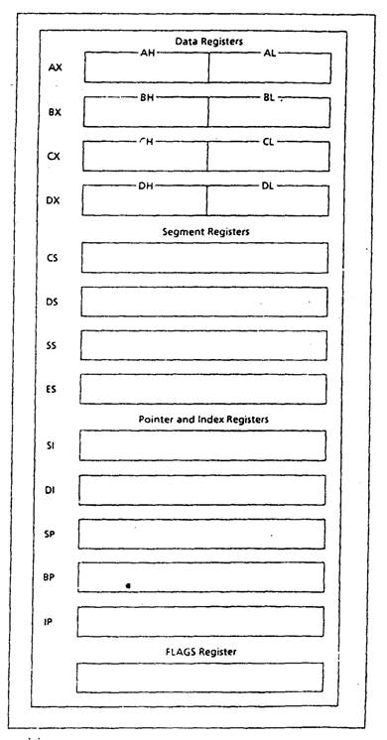
Register of 8086 Microprocessor

Slide 9
Register of 8086 Microprocessor
Data Register: Manipulates data.
AX (Accumulator Register): Used in arithmetic, logic and data transfer instructions because it generates the shortest machine code.
BX (Base Register): It is mainly address register. It contains data pointer which is base index. It indirectly addresses the register.
CX (Count Register):
Program loop construction.
String manipulation.
Acts as a counter in shift or rotate instruction.
DX (Data Register):
Works as the port number during the input and output operation.
Used in multiplication and division.

Slide 10
Register of 8086 Microprocessor
Segment Register: Stores address of instructions and data.
CS (Code Segment): Used for storing instructions.
DS (Data Segment): Used for storing data.
SS (Stack Segment): Used as stack and store returning address.
ES (Extra Segment): Used for storing destination data.

Slide 11
Register of 8086 Microprocessor
Pointer and Index Register: Points to the memory location. It is used in arithmetic and other operations.
SP (Stack Pointer): Used for accessing the stack segment (SS).
BP (Base Pointer): Used primarily to access data on the stack.
SI (Source Index): Used to point memory locations in the data segment addressed by DS.
DI (Destination Index): Performs the same functions as SI.

Slide 12
Register of 8086 Microprocessor
Flag Register: To indicate the status of the microprocessor. It contains the status and control flag.
Status flag: Reflects the result of an instruction executed by the CPU.
Control flag: Used to enable or disable certain operation of microprocessor.

Slide 13
Instruction set of 8086 microprocessor.
Data Transfer Instructions:
Instruction | Description
MOV | Transfer data between registers or between register and memory.
PUSH | Push register/memory data onto the stack.
POP | Pop data from stack into register/memory.
XCHG | Exchange data between two registers/memory.
IN | Input from a port to register.
OUT | Output from register to a port.
LEA | Load effective address of memory into a register.

Slide 14
Instruction set of 8086 microprocessor.
Arithmetic Instructions:
Instruction | Description
ADD | Add two values.
ADC | Add with carry.
SUB | Subtract one value from another.
SBB | Subtract with borrow.
MUL | Unsigned multiplication.
IMUL | Signed multiplication.
DIV | Unsigned division.
IDIV | Signed division.
INC | Increment value by 1.
DEC | Decrement value by 1.
NEG | Negate (2’s complement).
CMP | Compare two values (subtract but don’t store result).

Slide 15
Instruction set of 8086 microprocessor.
Logical Instructions:
Instruction | Description
AND | Logical AND.
OR | Logical OR.
XOR | Logical Exclusive OR.
NOT | Logical Complement.
TEST | Logical AND (Result not stored).

Slide 16
Instruction set of 8086 microprocessor.
Shift and Rotate Instructions:
Instruction | Description
SHL | Shift bits left.
SHR | Shift bits right.
ROL | Rotate bits left.
ROR | Rotate bits right.
RCL | Rotate through carry left.
RCR | Rotate through carry right.

Slide 17
Instruction set of 8086 microprocessor.
Branching Instructions (Control Transfer Instructions):
Instruction | Description
JMP | Unconditional jump.
RET | Return from a subroutine.
JE / JZ | Jump if equal (zero flag set).
JNE / JNZ | Jump if not equal (zero flag clear).
JG | Jump if greater.
JL | Jump if less.
JGE | Jump if greater or equal.
JLE | Jump if less or equal.
LOOP | Loop with CX register.
INT | Interrupt execution.

Slide 18
Instruction set of 8086 microprocessor.
String Manipulation Instructions:
Instruction | Description
MOVS | Move string from one location to another.
LODS | Load string element into AL/AX.
STOS | Store string element from AL/AX.
SCAS | Scan a string for a value.
CMPS | Compare two strings.
REP | Repeat instruction while CX ≠ 0.

Slide 19
Instruction set of 8086 microprocessor.
Processor Control Instructions:
Instruction | Description
STC | Set Carry flag.
CLC | Clear Carry flag.
CMC | Complement Carry flag.
STD | Set Direction flag.
CLD | Clear Direction flag.
STI | Set Interrupt flag (enable interrupts).
CLI | Clear Interrupt flag (disable interrupts).
HLT | Halt processor execution.
NOP | No operation (does nothing).
WAIT | Wait for processor signal.
ESC | Escape (for co-processor operations).
LOCK | Lock the bus to prevent other processors from accessing it.

Slide 20
Instruction set of 8086 microprocessor.
The 8086 instruction set consists of:
Data Transfer Instructions: Move data.
Arithmetic Instructions: Perform calculations.
Logical Instructions: Bitwise operations.
Shift and Rotate Instructions: Bit manipulation.
Branching Instructions: Control program flow.
String Instructions: Process strings.
Processor Control Instructions: Control CPU operations.

